Slide 1
North Wind Traders (NWT)
Darryl Ho Jun Xi (S10220892A)
Lew Zhi Xin (S10242881A)
Ho Jun Wei (S10220918B)
Qui Yu Xuan (S10243436F)
Eng Zhen Ye (S10243329J)
Notes:
Darryl

Slide 2

Content Page
01
02
03
04
Analytics or insights useful to NWT’s management
Project Overview, Product Backlog, etc
Individual Dashboard
Link to Trello board, GitHub, Snowflake
Notes:
Darryl

Slide 3




Analytics/insights useful for NWT
Sales Performance
Supplier Relationship
Evaluate supplier performance to negotiate better terms and enhance supply chain efficiency.
Determine best-selling products and peak sales periods by region to refine inventory management and regional marketing campaigns.
Analyze customer transactions to tailor marketing efforts and improve customer engagement.
Monitor sales team productivity to inform training needs and commission structures.
Customer Purchase Behaviour
Employee Performance
Notes:
Zhi Xin

Slide 4



Project Overview
Modernize NWT's data and reporting solutions.
Purpose
Migrate to Snowflake, establish OLAP, develop data warehouse, enhance reporting.
Scope
Scalability, reduced operational load, improved reporting speed, data security, data-driven decisions.
Objectives
Notes:
Zhi Xin
Our aim is to modernize North Wind Traders’ data and reporting solutions. Moving on to the scope is to migrate to Snowflake and establish OLAP which will serve as the backbone for our data warehouses. Lastly, our objectives is to scale up our operations and also reduce operational load on our teams, speed up our reporting, ensure the security of our data, and, most importantly, make decisions that are driven by accurate, real-time data.

Slide 5
Sprint Goals
01
Identify reporting needs and create tables in Snowflake
Sprint 1
02
Load the data into Snowflake and clean the data
Sprint 2
03
Link the data from Snowflake into Power BI
Sprint 3
SCRUM Goals
04
Manage updated order information and develop dashboards
Sprint 4
05
Finalize the release solution
Sprint 5
Notes:
Jun Wei
In sprint one, our sprint goal was to “Identify reporting needs and create tables in Snowflake”. During this sprint, our team collaborated with the product owner to understand any data requirements or considerations as well as identify primary and foreign key relationships to ensure a seamless integration and migration experience.
In the second sprint, our sprint goal was to “Load the data into Snowflake and clean the data”. During this sprint, the team first decided to make use of SnowSQL in Visual Studio Code to create and clean the data.
In sprint 3, our sprint goal was to “Link the data from Snowflake into PowerBi so as to generate required reports in Power BI”. Over the course of this sprint, we first established a secure live data pipeline connection from Snowflake to PowerBi using direct query.
In the fourth sprint, our sprint goal was to “manage updated order information and develop dashboards”. Throughout this sprint, the team actively implemented and monitored the Continuous Integration/Continuous Deployment (CI/CD) pipeline to guarantee the seamless incorporation of added order details.
In the fifth and last sprint, our sprint goal was to “Finalize the release product” which includes tying up any loose ends and to add and enhance our dashboards to better display what is needed for the business owner.

Slide 6
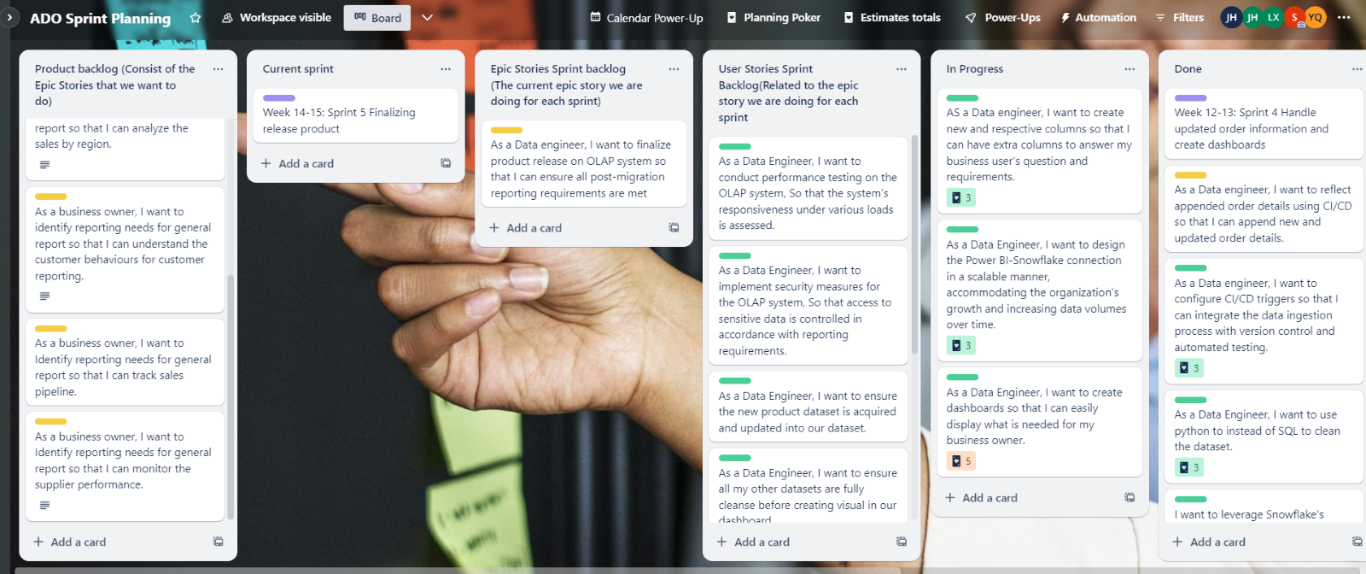
Product Backlog (Trello board)
Notes:
Jun Wei

Slide 7
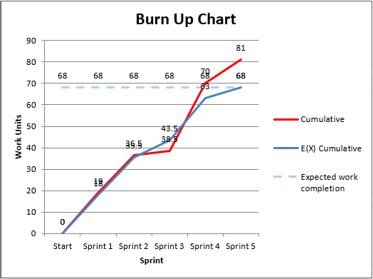
Burn Up Chart
Notes:
zy

Slide 8
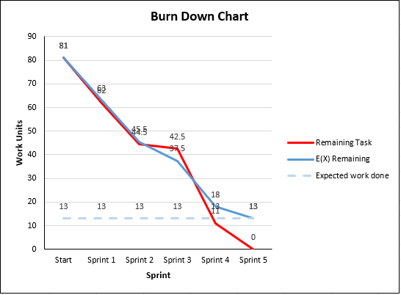
Burn Down Chart
Notes:
zy

Slide 9
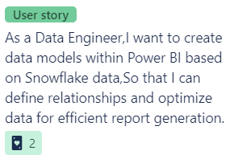
Formatting of User Stories
As a <User>,
I want to <objective>,
so that I can <outcome>
Effort: <number 1-5>
Notes:
Yx
For the formatting of the user stories, “As a <user>, I want to <objective>, so that I can <outcome>” then the effort from 1 to 5. for example, as a data engineer, I want to create data model within power bi based on snowflake data, so that I can define relationships and optimise data for efficient report generation. With an effort of 2.

Slide 10
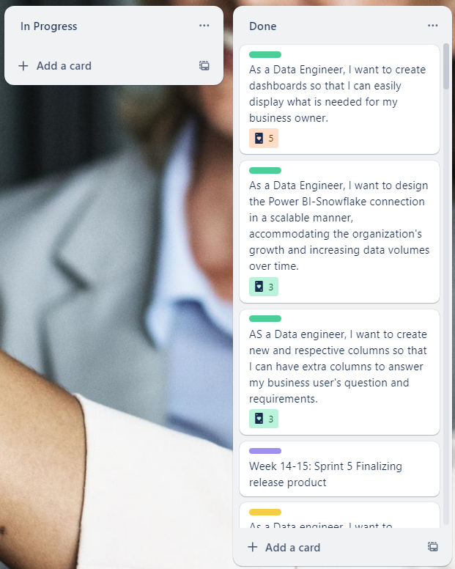
Sprint Backlog
Notes:
Yx
This is our sprint backlog showing what is done.
One section for in progress n one section for done. For done section, it is split into all the different sprints.

Slide 11
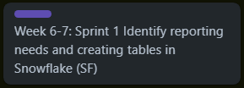
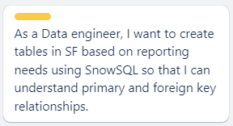
Sprint Backlog 1
Scrum Master: Yu Xuan
Sprint Goal
Epic Story
Notes:
For the first sprint, our sprint goal is to identify reporting needs and creating tables in snowflake. Our epic story for this sprint is that as a data engineer, I want to create tables in snowflake based on the reporting needs using snowsql so that I can understand primary and foreign key relationships.

Slide 12
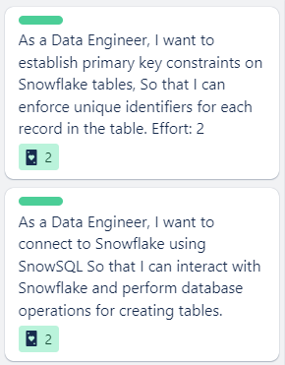
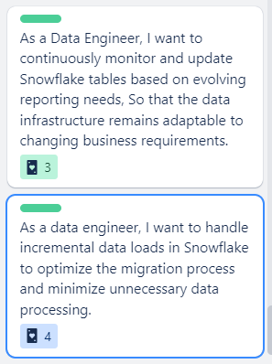
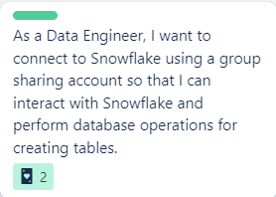
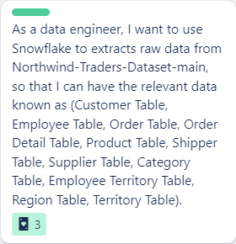
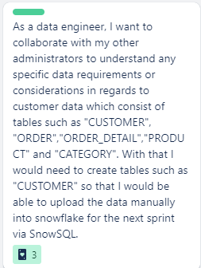
Sprint Backlog 1 (User Stories)
User Story ID 1
Jun Wei
User Story ID 4
Darryl
User Story ID 5
Zhen Ye
User Story ID 2
Yu Xuan
User Story ID 3
Zhi Xin
Notes:
These are five user stories for that one epic story, first user story is, as a data engineer, I want to establish primary key constraints on snowflake tables, so that I can enforce unique identifiers for each record in the table. The second user story is that as a data engineer, I want to connect to snowflake using a group sharing account so that I can interact with snowflake and perform database operations for creating tables. For the third user story, as a data engineer, I want to use snowflake to extract raw data from Northwind-traders-dataset-main, so that I can have the relevant data known as customer, employee, order, order detail, product, shipper, supplier, category, employee territory, region and territory table. As a data engineer, I want to collaborate with my other administrators to understand my specific data requirements or considerations, ensuring a seamless integration and migration experience. And the final user story is as a data engineer, I want to continuously monitor and update snowflake tables based on evolving reporting needs, so that the data infrastructure remains adaptable to changing business requirements.

Slide 13
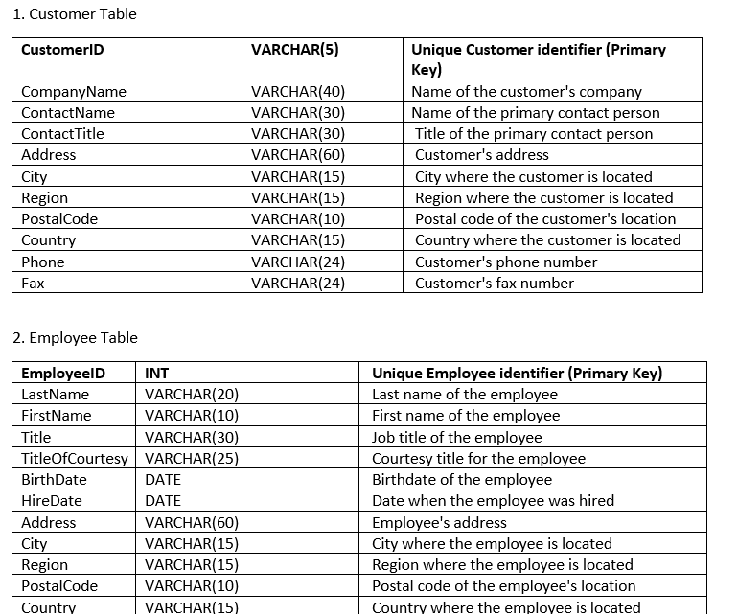
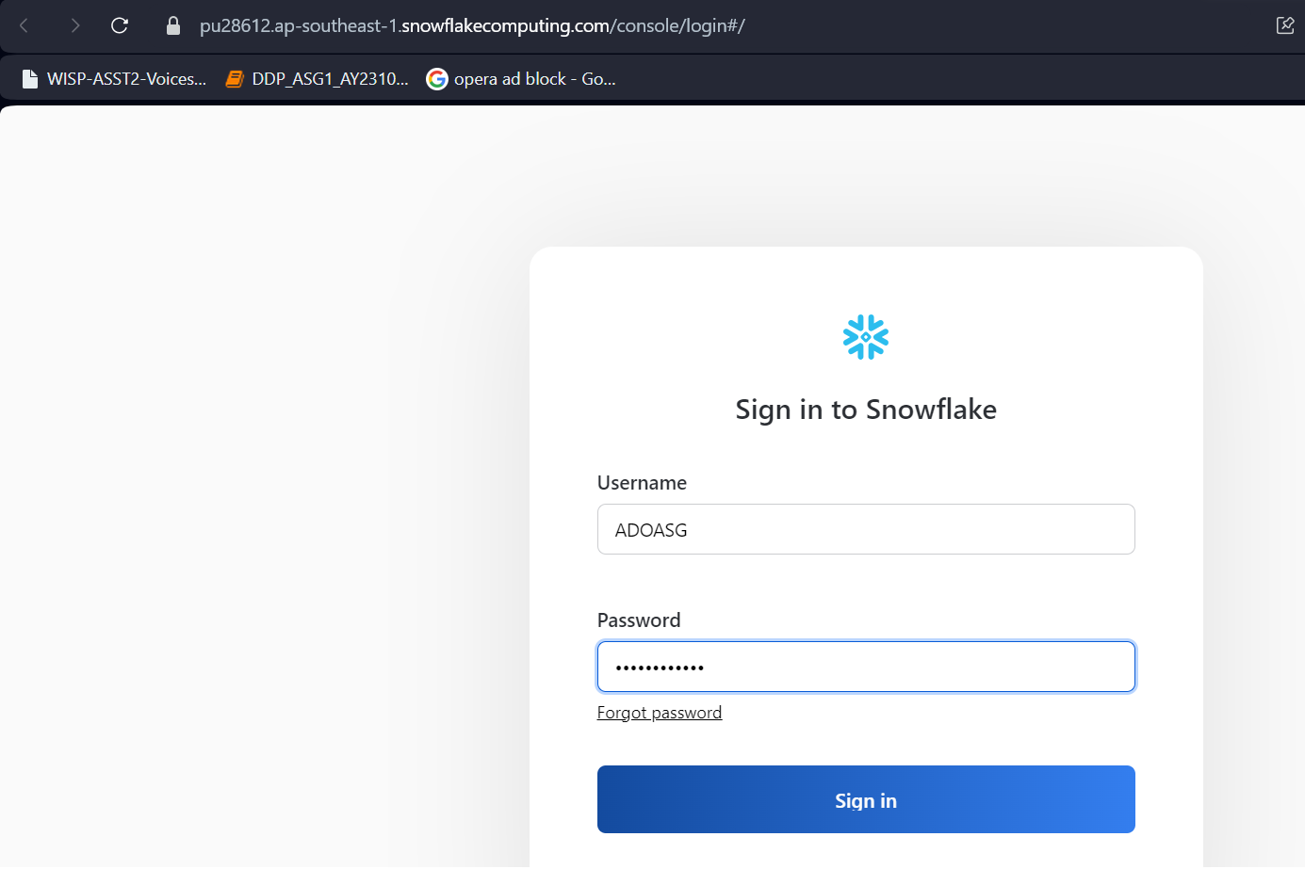
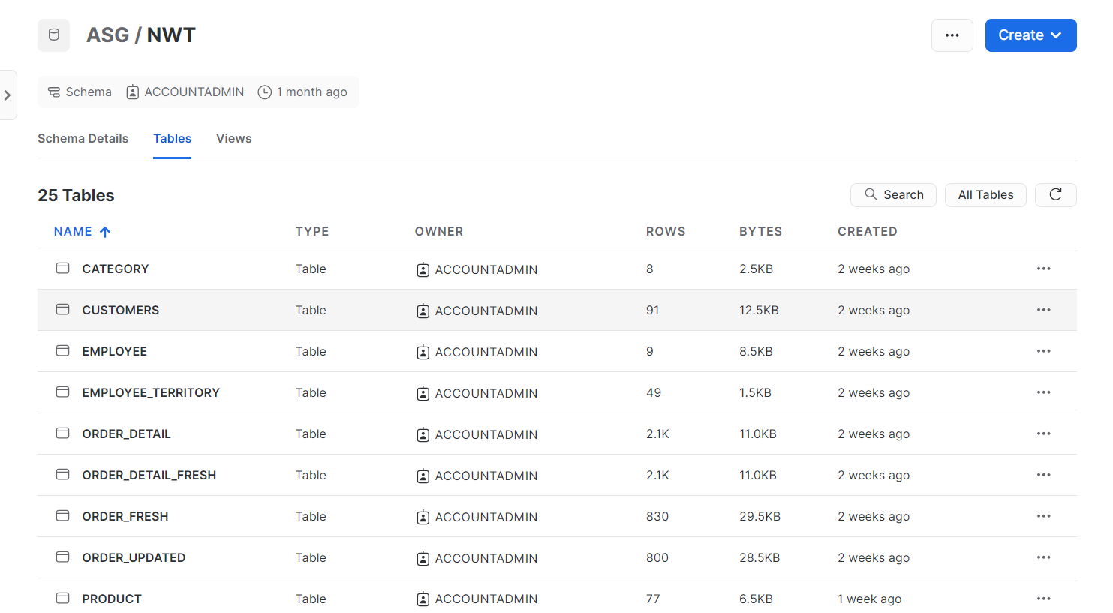
Sprint Backlog 1(User Stories)
User Story ID 1
User Story ID 2
User Story ID 3
Notes:
Yu xuan set up the snowflake
In the initial sprint, I set up a Snowflake account and distributed the credentials to my team, enabling them to log in and collectively review the modifications. Following this, I generated tables based on the metadata, incorporating primary and foreign keys along with data types. Subsequently, I executed SQL queries to load the data into the created tables.

Slide 14
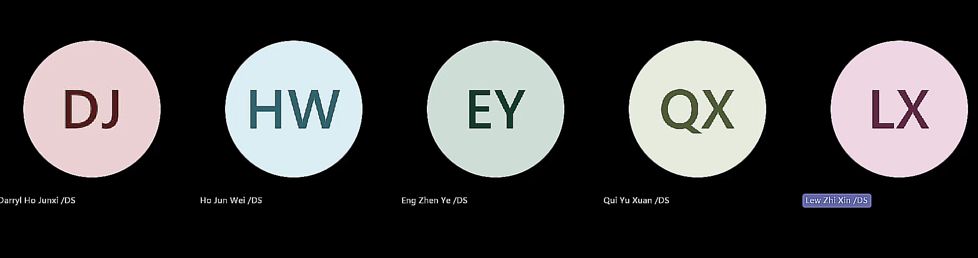
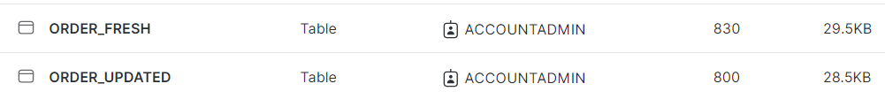
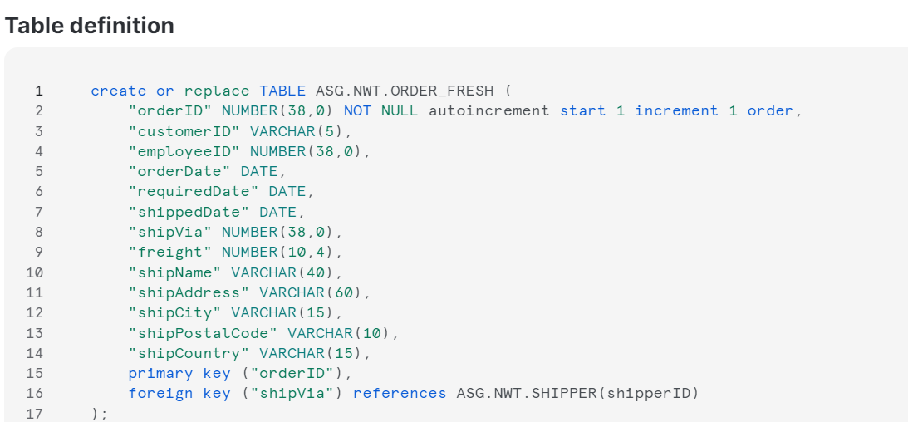
Sprint Backlog 1(User Stories)
User Story ID 4
User Story ID 5
Notes:
Subsequently, I collaborated with fellow administrators to comprehend any particular data requirements or considerations. Moving forward, I aimed to consistently monitor and update Snowflake tables to align with evolving reporting needs, such as ensuring the freshness of tables related to new orders through regular updates.

Slide 15
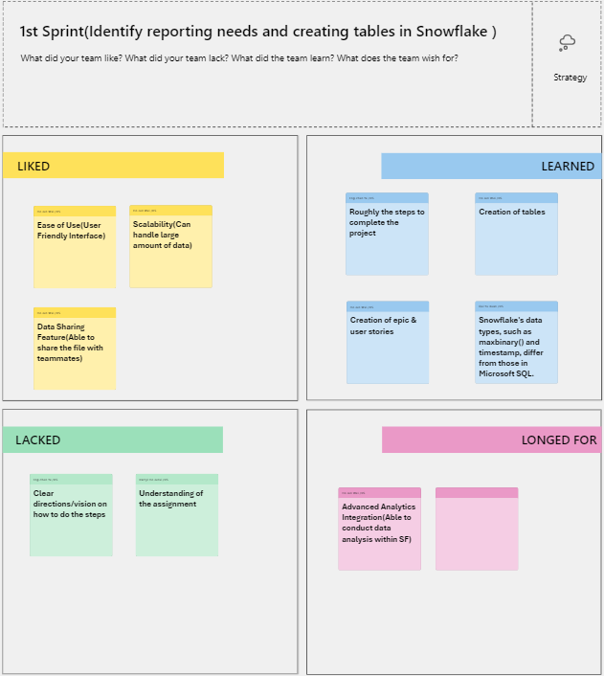
1st Sprint Retrospective
Notes:
For the first sprint retrospective, this are the improvements, what was lacking, liked, learned, and wanted for a long time. What was liked in the first sprint was the ease of use like user friendly interface, what was learned was creation of tables, epic stories, and user stories. What was lacking was the understanding of the assignment and what was wanted for a long time was the advanced analytics integration, being able to conduct data analyses within snowflake.

Slide 16








ELT Pipeline
Warehouse
Transform
DBT
Cloud
SnowSQL
Push
OR
Extract data from GitHub
Connect Snowflake to Jupyter
&
Clean
Load it into Jupyter (Python)
Notes:
We initiated the Extract, Load, and Transform (ELT) pipeline by extracting data from the Northwind Traders GitHub repository. After extracting, we loaded the data into Jupyter or Snow SQL. We established a connection between Snowflake and Jupyter for seamless data transfer. Following the data loading, We performed data cleaning within Jupyter and stored the refined dataset back into Snowflake. Subsequently, We executed a transformation process using dbt Cloud. Finally, We pushed and committed the transformed data to our shared GitHub repository.

Slide 17

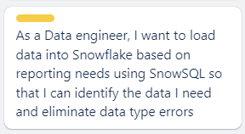
Sprint Backlog 2
Scrum Master: Zhen Ye
Sprint Goal
Epic Story

Slide 18
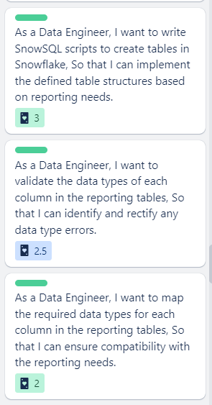
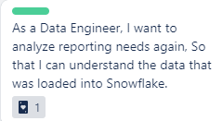
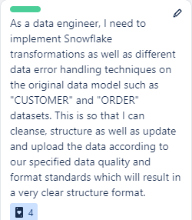
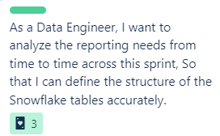
Sprint Backlog 2(User Stories)
User Story ID 1
Zhi Xin
User Story ID 5
Zhen Ye
User Story ID 4
Darryl
User Story ID 2
Jun Wei
User Story ID 3
Yu Xuan

Slide 19
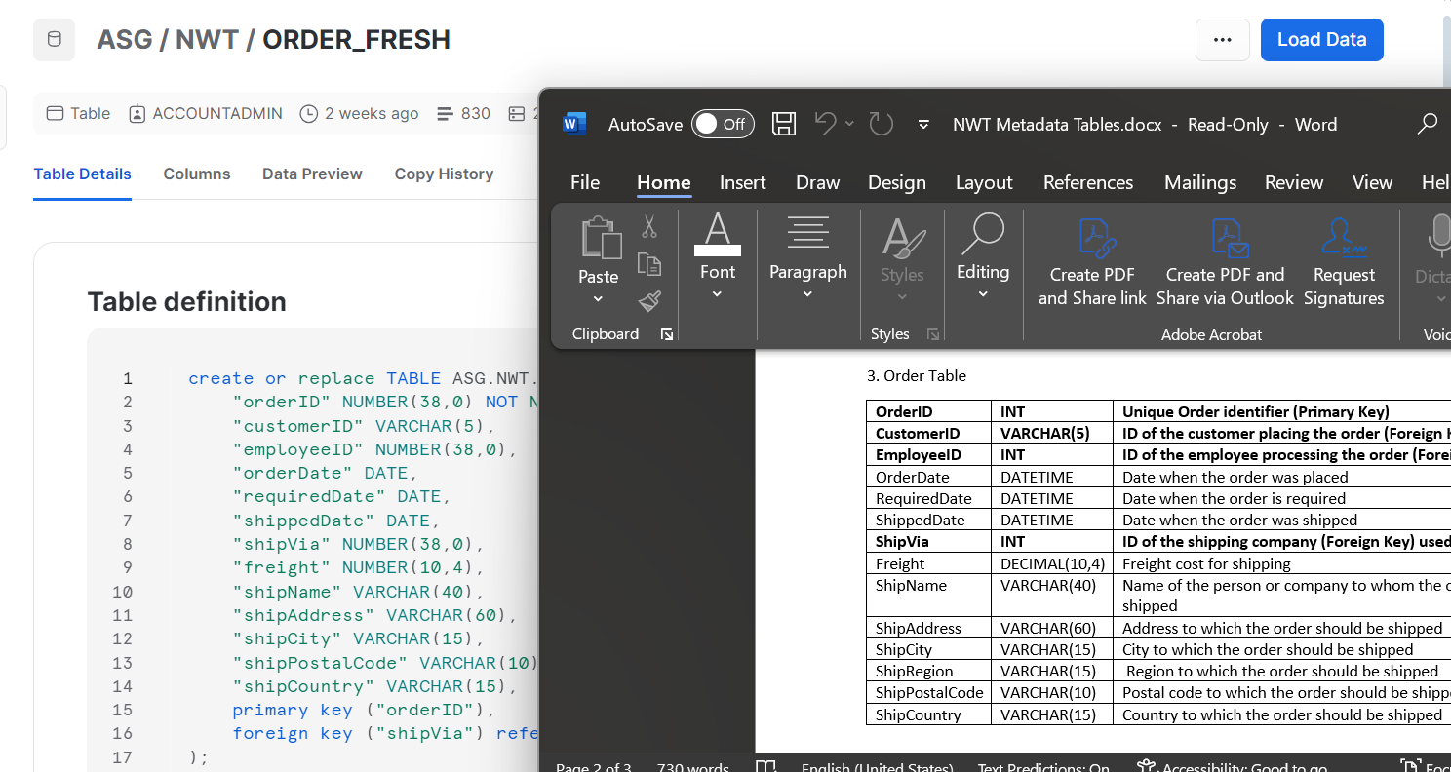
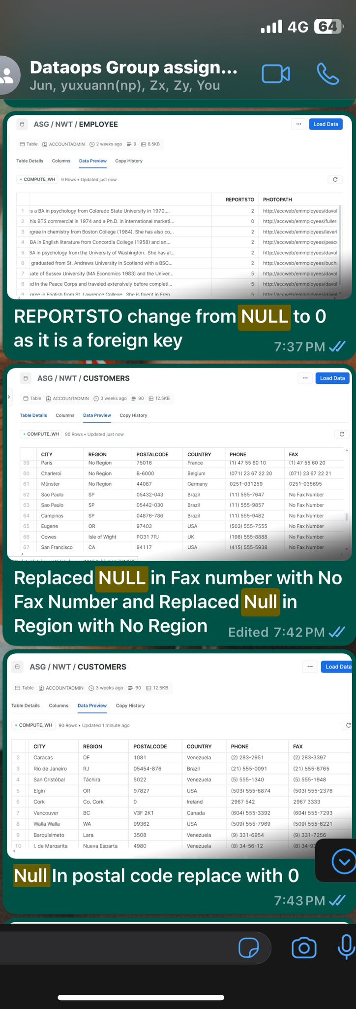
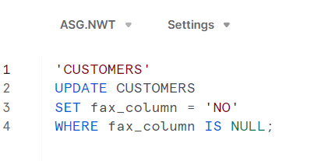
Sprint Backlog 2(User Stories)
User Story ID 1
User Story ID 2
User Story ID 4

Slide 20
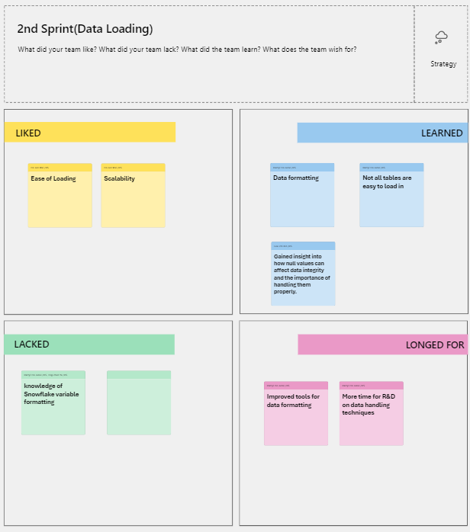
2nd Sprint Retrospective

Slide 21
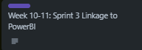
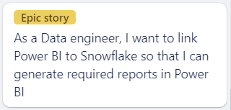
Sprint Backlog 3
Scrum Master: Jun Wei
Sprint Goal
Epic Story

Slide 22
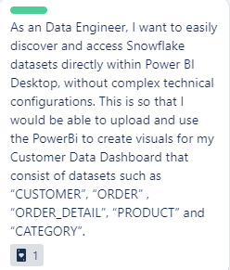
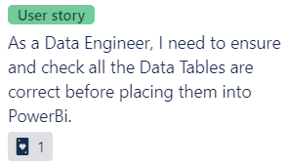
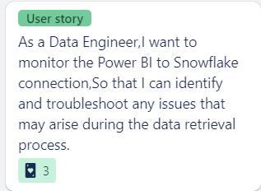
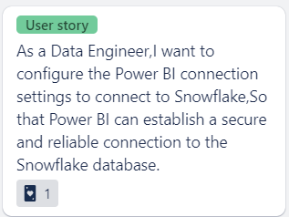
Sprint Backlog 3 (User Stories)
User Story ID 1
Darryl
User Story ID 5
Yu Xuan
User Story ID 2
Zhi Xin
User Story ID 4
Zhen Ye
User Story ID 3
Jun Wei

Slide 23
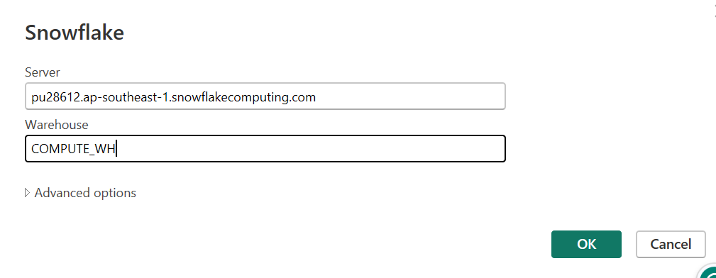
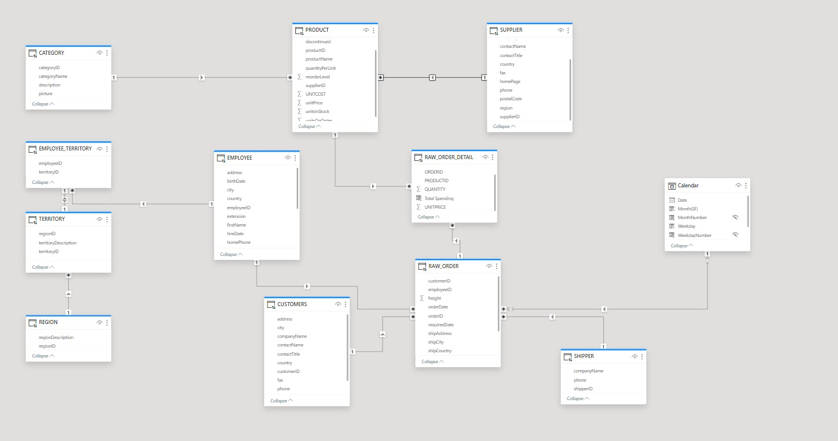
Sprint Backlog 3(User Stories)
User Story ID 1
User Story ID 3

Slide 24
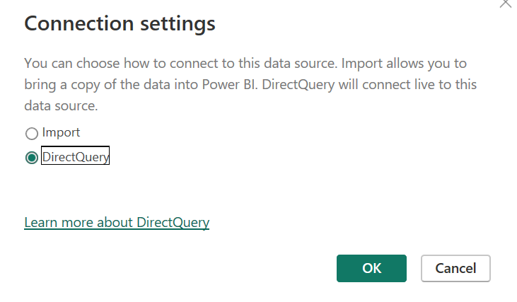
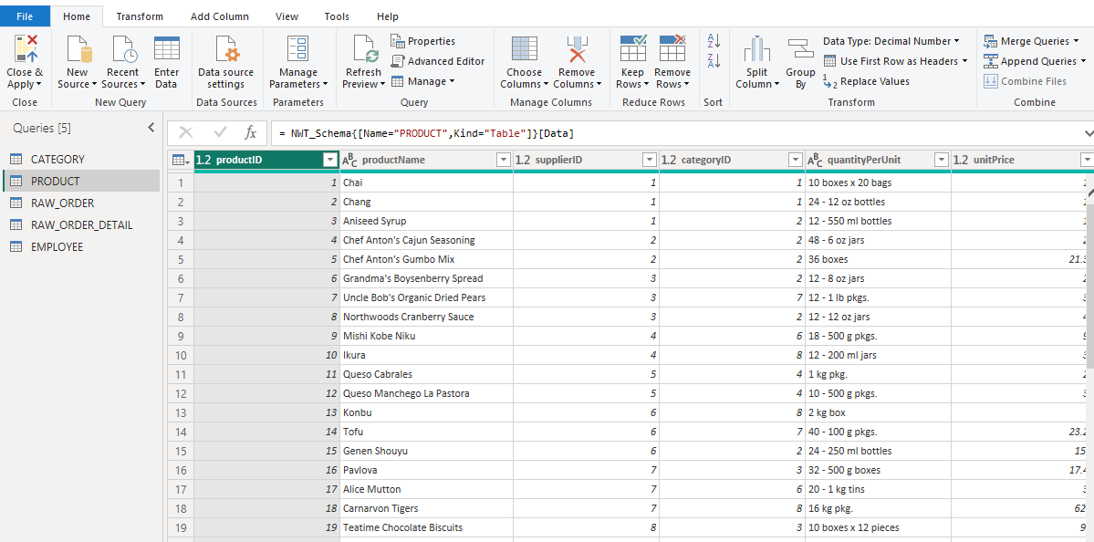
Sprint Backlog 3(User Stories)
User Story ID 4
User Story ID 5

Slide 25
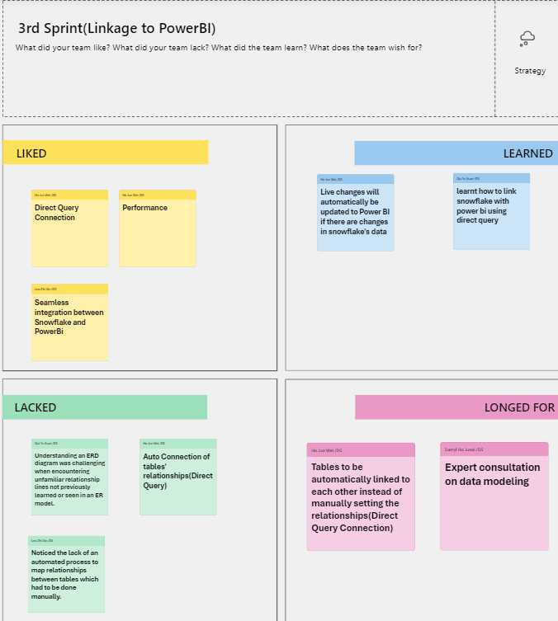
3rd Sprint Retrospective

Slide 26
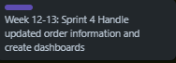
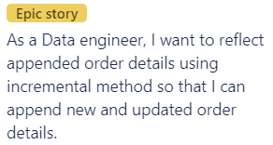
Sprint Backlog 4
Scrum Master: Zhi Xin
Epic Story

Slide 27

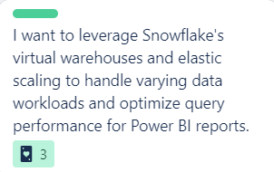

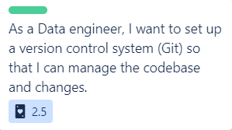
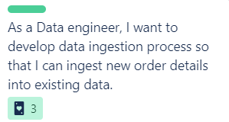
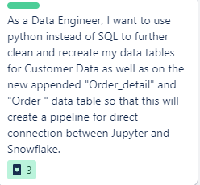
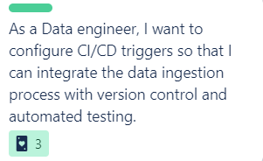
Sprint Backlog 4
User Story ID 1
Jun Wei
User Story ID 7
Yu Xuan
User Story ID 2
Zhi Xin
User Story ID 6
Zhen Ye
User Story ID 3
Zhi Xin
User Story ID 4
Darryl
User Story ID 5
Yu Xuan

Slide 28
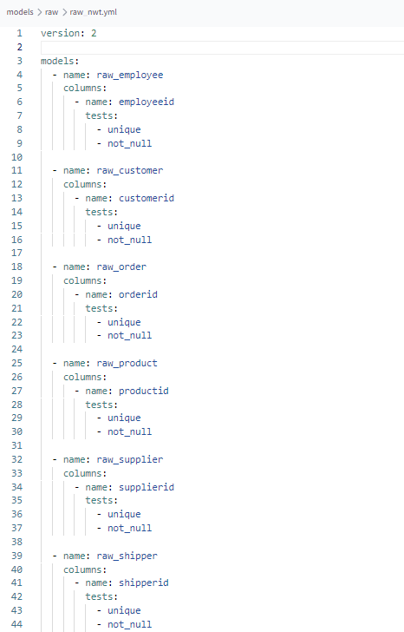
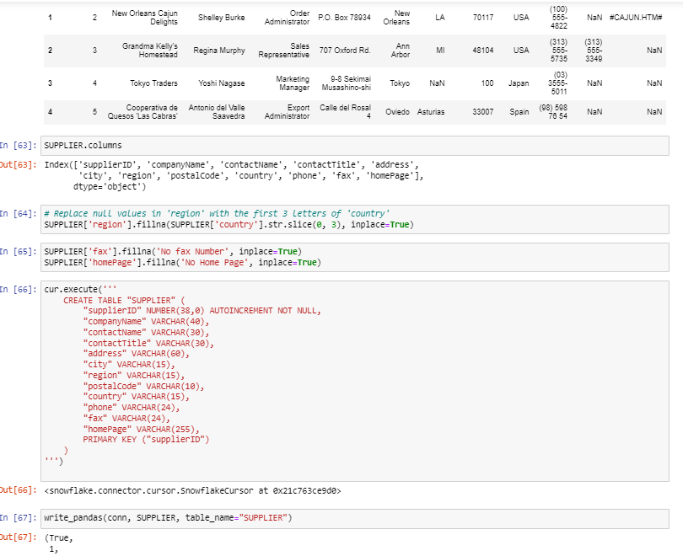
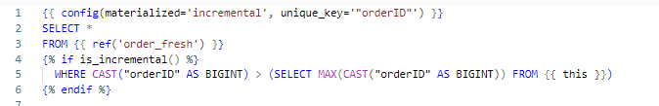
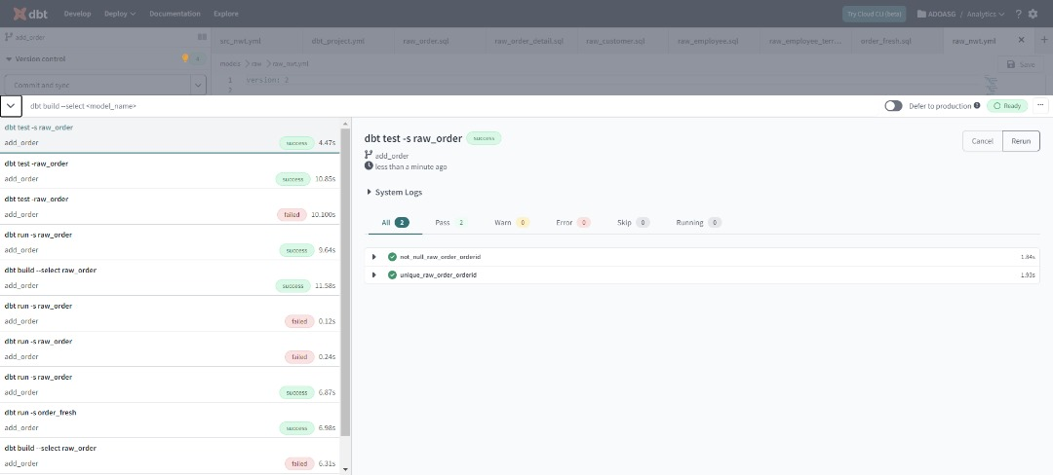
Sprint Backlog 4(User Stories)
User Story ID 4
User Story ID 2
User Story ID 3
Notes:
We have created YML files which is part of data testing strategy. The tests are run as part of the dbt run process and are used to validate the data against the defined constraints, ensuring data quality and integrity. If any of these tests fail, it indicates a data quality issue that needs to be addressed, such as duplicate IDs or unexpected null values in critical fields.
I have then used the incremental method to append new orders to raw order where the orderid should be unique and not null after appending. To ensure the orderid is unique and not null, I ran the dbt test and looking from this image we can see that the test is run successfully. Moving on, after appending the new orders, we then decided to clean our data using python in Jupyter.

Slide 29


Sprint Backlog 4(User Stories)
User Story ID 7
Notes:
These are the branches created in dbt which is linked to github. We will commit any changes in these branches which will be updated in github when pushed.

Slide 30

4th Sprint Retrospective

Slide 31


Sprint Backlog 5
Scrum Master: Darryl
Sprint Goal
Epic Story

Slide 32





Sprint Backlog 5
User Story ID 1
Yu Xuan
User Story ID 5
Jun Wei
User Story ID 2
Zhen Ye
User Story ID 4
Darryl
User Story ID 3
Zhi Xin

Slide 33


Sprint Backlog 5(User Stories)
User Story ID 2

Slide 34




Sprint Backlog 5(User Stories)
User Story ID 3

Slide 35



Sprint Backlog 5(User Stories)
User Story ID 4

Slide 36


Sprint Backlog 5(User Stories)
User Story ID 4

Slide 37

5th Sprint Retrospective

Slide 38

Dashboards
Sales Overview
Sales Agent Tracking
Supplier Reporting
Customer Reporting

Slide 39






Slide 40

Datasets Used
Raw_Order
Raw_Order_Detail
Product
Region
Category
Territory
Notes:
This dashboard provides an overview of Northwind Traders' sales performance by region. It highlights key metrics, such as 830 total orders generating $1.35 million in revenue and selling 51.32 thousand units. The dashboard features a slicer for users to focus on specific years.
The first visual displays a map depicting profit margins by city. Upon zooming in, it becomes evident that cities in the United States contribute significantly to the highest profits. This suggests an opportunity for Northwind Traders to expand its customer base in the United States.
The second visual, a pie chart, showcases total revenue distribution by region. The Eastern region stands out, contributing 52.1% of the total profit, while the Southern region lags behind at 15.73%. This insight allows users to filter and concentrate efforts on specific regions for sales and category focus.
The third visual, a line chart, illustrates profit margins for the top five products. Notably, "Geitost" boasts the highest profit margin at 55.94%, while "Tunnbrod" ranks fifth with a 52.07% profit margin. This information guides promotional efforts and optimization strategies.
The fourth visual presents the sum of reorder levels by category, highlighting beverages with the highest reorder level of 195 and products with the lowest at 25. This data aids in identifying popular products in specific regions, indicating strong demand and customer satisfaction.
The final visual, a combination of a line and bar chart, displays profits and profit margins by region description. While the Eastern region leads in profits at $252.7 thousand, it has a lower profit margin of 35.82%. In contrast, the Southern region, with a slightly lower profit, boasts a higher profit margin of 37.03%. This observation prompts Northwind Traders to consider strategies for improving customer satisfaction and exploring pricing adjustments without compromising profit margins.
In conclusion, utilizing this dashboard, users can delve into regional sales analysis, providing valuable insights to enhance Northwind Traders' sales performance. This, in turn, is expected to contribute to increased revenue and profitability for the company.

Slide 41




Notes:
This dashboard provides an overview of Northwind Traders' sales performance by region. It highlights key metrics, such as 830 total orders generating $1.35 million in revenue and selling 51.32 thousand units. The dashboard features a slicer for users to focus on specific years.
The first visual displays a map depicting profit margins by city. Upon zooming in, it becomes evident that cities in the United States contribute significantly to the highest profits. This suggests an opportunity for Northwind Traders to expand its customer base in the United States.
The second visual, a pie chart, showcases total revenue distribution by region. The Eastern region stands out, contributing 52.1% of the total profit, while the Southern region lags behind at 15.73%. This insight allows users to filter and concentrate efforts on specific regions for sales and category focus.
The third visual, a line chart, illustrates profit margins for the top five products. Notably, "Geitost" boasts the highest profit margin at 55.94%, while "Tunnbrod" ranks fifth with a 52.07% profit margin. This information guides promotional efforts and optimization strategies.
The fourth visual presents the sum of reorder levels by category, highlighting beverages with the highest reorder level of 195 and products with the lowest at 25. This data aids in identifying popular products in specific regions, indicating strong demand and customer satisfaction.
The final visual, a combination of a line and bar chart, displays profits and profit margins by region description. While the Eastern region leads in profits at $252.7 thousand, it has a lower profit margin of 35.82%. In contrast, the Southern region, with a slightly lower profit, boasts a higher profit margin of 37.03%. This observation prompts Northwind Traders to consider strategies for improving customer satisfaction and exploring pricing adjustments without compromising profit margins.
In conclusion, utilizing this dashboard, users can delve into regional sales analysis, providing valuable insights to enhance Northwind Traders' sales performance. This, in turn, is expected to contribute to increased revenue and profitability for the company.

Slide 42




Notes:
This dashboard provides an overview of Northwind Traders' sales performance by region. It highlights key metrics, such as 830 total orders generating $1.35 million in revenue and selling 51.32 thousand units. The dashboard features a slicer for users to focus on specific years.
The first visual displays a map depicting profit margins by city. Upon zooming in, it becomes evident that cities in the United States contribute significantly to the highest profits. This suggests an opportunity for Northwind Traders to expand its customer base in the United States.
The second visual, a pie chart, showcases total revenue distribution by region. The Eastern region stands out, contributing 52.1% of the total profit, while the Southern region lags behind at 15.73%. This insight allows users to filter and concentrate efforts on specific regions for sales and category focus.
The third visual, a line chart, illustrates profit margins for the top five products. Notably, "Geitost" boasts the highest profit margin at 55.94%, while "Tunnbrod" ranks fifth with a 52.07% profit margin. This information guides promotional efforts and optimization strategies.
The fourth visual presents the sum of reorder levels by category, highlighting beverages with the highest reorder level of 195 and products with the lowest at 25. This data aids in identifying popular products in specific regions, indicating strong demand and customer satisfaction.
The final visual, a combination of a line and bar chart, displays profits and profit margins by region description. While the Eastern region leads in profits at $252.7 thousand, it has a lower profit margin of 35.82%. In contrast, the Southern region, with a slightly lower profit, boasts a higher profit margin of 37.03%. This observation prompts Northwind Traders to consider strategies for improving customer satisfaction and exploring pricing adjustments without compromising profit margins.
In conclusion, utilizing this dashboard, users can delve into regional sales analysis, providing valuable insights to enhance Northwind Traders' sales performance. This, in turn, is expected to contribute to increased revenue and profitability for the company.

Slide 43


Notes:
This dashboard provides an overview of Northwind Traders' sales performance by region. It highlights key metrics, such as 830 total orders generating $1.35 million in revenue and selling 51.32 thousand units. The dashboard features a slicer for users to focus on specific years.
The first visual displays a map depicting profit margins by city. Upon zooming in, it becomes evident that cities in the United States contribute significantly to the highest profits. This suggests an opportunity for Northwind Traders to expand its customer base in the United States.
The second visual, a pie chart, showcases total revenue distribution by region. The Eastern region stands out, contributing 52.1% of the total profit, while the Southern region lags behind at 15.73%. This insight allows users to filter and concentrate efforts on specific regions for sales and category focus.
The third visual, a line chart, illustrates profit margins for the top five products. Notably, "Geitost" boasts the highest profit margin at 55.94%, while "Tunnbrod" ranks fifth with a 52.07% profit margin. This information guides promotional efforts and optimization strategies.
The fourth visual presents the sum of reorder levels by category, highlighting beverages with the highest reorder level of 195 and products with the lowest at 25. This data aids in identifying popular products in specific regions, indicating strong demand and customer satisfaction.
The final visual, a combination of a line and bar chart, displays profits and profit margins by region description. While the Eastern region leads in profits at $252.7 thousand, it has a lower profit margin of 35.82%. In contrast, the Southern region, with a slightly lower profit, boasts a higher profit margin of 37.03%. This observation prompts Northwind Traders to consider strategies for improving customer satisfaction and exploring pricing adjustments without compromising profit margins.
In conclusion, utilizing this dashboard, users can delve into regional sales analysis, providing valuable insights to enhance Northwind Traders' sales performance. This, in turn, is expected to contribute to increased revenue and profitability for the company.

Slide 44

Datasets Used
Raw_Order
Category
Product
Region
Raw_Order_Detail

Slide 45

User Stories

Slide 46

User Stories

Slide 47
User Stories

Slide 48


Slide 49
Tables Used
Category
Employee
Product
Order
Order_detail

Slide 50




User Stories

Slide 51


User Stories

Slide 52




User Stories

Slide 53
Datasets Used
Order
Order_Detail
Product
Suppliers
Category
Notes:
I have created this dashboard to analyze supplier performance. This dashboard includes slicer for the company name and year, where user can select the data for specific time periods or supplier as needed.

Slide 54




User Stories
Notes:
I have used a horizontal bar chart to show the top 5 and bottom 5 suppliers by salesthere are buttons incorporated at the top right of the chart, labeled "Top 5" and "Bottom 5". These interactive elements allow users to switch the view between the suppliers with the highest sales and those with the lowest,

Slide 55




User Stories
Notes:
I have used a donut chart to show the product discontinuation rates.
I have used a table to present a detailed breakdown of the average cost for products sourced from each supplier, categorized by product type.

Slide 56




User Stories
Notes:
100% stacked bar chart to display the product availability, which encompasses the sum of units in stock, the sum of units on order, and the sum of reorder levels for various products offered by Northwind Traders. This type of visualization is particularly effective in showing the proportion of each metric relative to the total inventory for a product.
stacked column chart to illustrate the distribution of profits across different product categories for each supplier that Northwind Traders works with.

Slide 57

Notes:
customer, order , order_detail,product and category dataset

Slide 58
Datasets Used
Customer
Order + Calendar
Order_detail
Product
Category
Notes:
customer, order , order_detail,product and category dataset

Slide 59

As a business analyst,I want a Tree chart in Power BI showing the top customers by the number of orders placed, So that I can identify key customer segments and inform strategies to enhance customer engagement and sales.
Notes:
customer, order , order_detail,product and category dataset

Slide 60

As a business analyst,I want a dashboard in Power BI that visualizes customer demographics, including a map for geographical distribution and if possible a segmented bar charts for other demographic variables,So that I can understand the diversity of our customer base and provide insights for personalized marketing and product development.
Notes:
customer, order , order_detail,product and category dataset

Slide 61

As a business analyst, I want to analyze order status through a table chart in Power BI,So that I can track order fulfilment efficiency, identify bottlenecks, and suggest improvements to the sales process.
Notes:
customer, order , order_detail,product and category dataset

Slide 62


As a business analyst,I want a line chart in Power BI that tracks customer purchase trends over time across different product categories using the Northwind Traders dataset,So that I can analyze how different customer segments contribute to overall profit performance, identify purchasing patterns and behaviors, and provide insights for customer-centric strategies and product offerings.
Notes:
customer, order , order_detail,product and category dataset

Slide 63

As a business analyst,I want interactive filters and slicers in the dashboard,So that I can segment and explore the data dynamically, enabling more in-depth and customized analysis.
Notes:
customer, order , order_detail,product and category dataset

Slide 64

As a business analyst, I want to analyze the customer purchase patterns and shipping volume so that I can understand the behavior of our customer base, optimize inventory management, and develop targeted strategies to increase customer retention and satisfaction.
Notes:
customer, order , order_detail,product and category dataset

Slide 65

Links to Snowflake, GitHub, Trello Board
Trello Board
https://trello.com/b/hibk1Q4H/ado-sprint-planning
Snowflake
Username: ADOASG
Password: Weloveado123
Link: https://pu28612.ap-southeast-1.snowflakecomputing.com
https://github.com/adoasg/asg2
GitHub
Username: adoasg2@gmail.com
Password: Weloveado123_
DBT CLoud

Slide 66

Thank You! ☺

